Slide 1
Case Study: Data Engineering Methodologies in Telecom Industry
Team Spark Trio Sparklers:
Taabish Khan
Shubham Bhosale
Sonalika Arella

Slide 2
Problem Statement Understanding

Slide 3
Data Source
Data Cleaning
Monthly Billing Report
Customer Complaints & Network Metrics Visualization

Slide 4
Solution Proposed

Slide 5
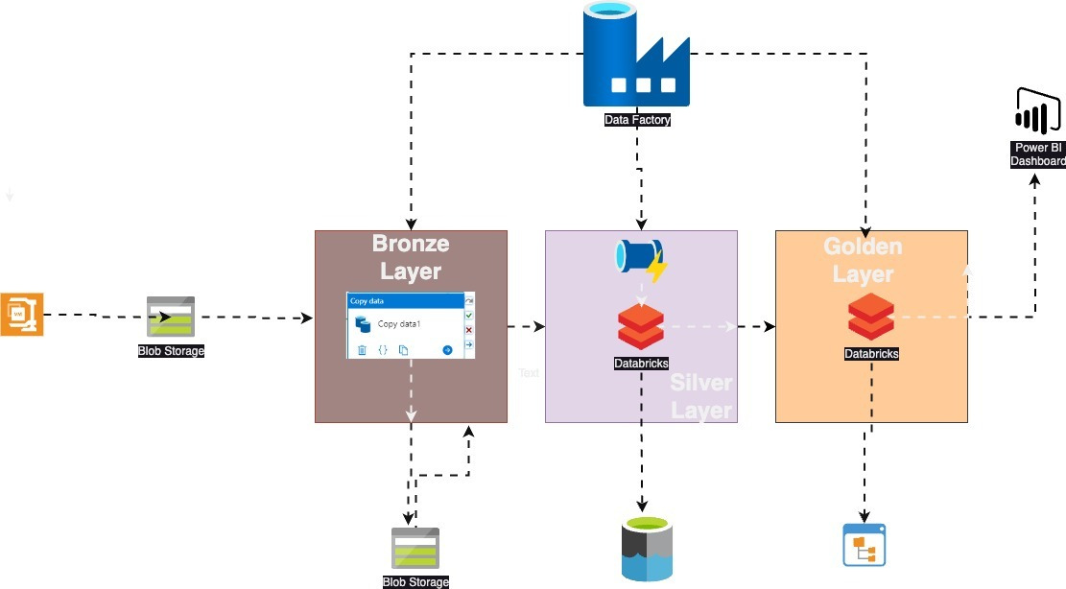
Architecture Diagram & Workflow

Slide 6
Challenges and Solution

Slide 7
Data Cleansing issue
Data Storage issue
Issue of Connecting Power BI with ADLS
Issue of manually debugging the pipeline

Slide 8
Learning Outcome

Slide 9
Medallion Architecture
Storage Trigger
ETL Steps using Azure Data Factory & Databricks
Visualisation & creation of Dashboards using Power BI
Learnt about the Azure Storage and hierarchies

Slide 10


Slide 11


